Slide 1
Barnwell School – Physical Education Department
PE Kit Per Activity

Slide 2
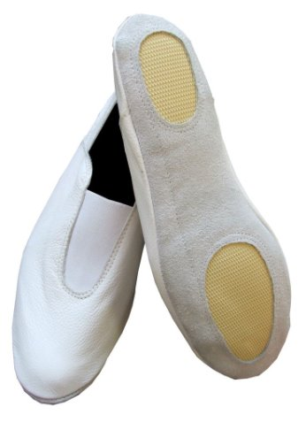
Gymnastics
Kit
Barnwell PE Polo top​
Barnwell PE shorts
Hairband (for long hair)​
No hoodies​
Optional:​
Barnwell PE tracksuit bottoms​
Barnwell PE sports leggings
FOOTWEAR​
Students participate in gymnastics barefoot​
No trainers​
Optional:​
Gymnastics ​shoes​

Slide 3
Football
KIT​
Barnwell PE Polo top​
Barnwell PE shorts
Red football socks​
Hairband (for long hair)​
Shin pads​
Optional:​
Barnwell PE tracksuit bottoms​
Barnwell PE hoodie​
Barnwell PE sports leggings​
Black or red base layer to be worn underneath PE polo​
FOOTWEAR​
Students can wear:​
Football boots with rubber studs​
Astro turf boots​
No trainers​
No football boots with metal tipped studs​

Slide 4
Rugby
KIT​
Barnwell PE Polo top​
Barnwell PE shorts​
Red football socks​
Gum shield​
Hairband (for long hair)​
Optional:​
Barnwell PE tracksuit bottoms​
Barnwell PE hoodie​
Barnwell PE sports leggings​
Black or red base layer to be worn underneath PE polo​
FOOTWEAR​
Students can wear:​
Football boots with rubber studs​
Football boots with metal tipped studs​
Rugby boots​
No trainers

Slide 5
All other activities
KIT​
Barnwell PE Polo top​
Barnwell PE shorts
Red football socks​
Gum shield​
Hairband (for long hair)​
Optional:​
Barnwell PE tracksuit bottoms​
Barnwell PE hoodie​
Barnwell PE sports leggings​
Black or red base layer to be worn underneath PE polo​
FOOTWEAR​
Students can wear:​
Trainers with laces​
Trainers with velcro​
No school shoes​

